Slide 1



WANDERLUST

Slide 2


DESCRIPTION :
•The Wanderlust Android application is designed for travelers who want to keep track of their journey experiences. Here are some key features:
•Trip Diary: Users can save their journeys in the form of a trip diary, keeping all their travel experiences organized in one place
•Exploring New Places: Users can Explore new places of the city/town, and the app suggests the Best.
•Suggesting Residents: This App suggests the Best Residents and Hotels for Stays
•Planning your Day: App schedules your Day of Vacation on its Best way.
•Provides Details on Local Places: This App provides the best details for the user on its local tourism.

Slide 3
Source Code :
package com.example.travelapp
import android.content.Context
import android.content.Intent
import android.os.Bundle
import androidx.activity.ComponentActivity
import androidx.activity.compose.setContent
import androidx.compose.foundation.Image
import androidx.compose.foundation.clickable
import androidx.compose.foundation.layout.*
import androidx.compose.foundation.rememberScrollState
import androidx.compose.foundation.verticalScroll
import androidx.compose.material.Card
import androidx.compose.material.Text

Slide 4
import androidx.compose.runtime.Composable
import androidx.compose.ui.Alignment
import androidx.compose.ui.Modifier
import androidx.compose.ui.draw.scale
import androidx.compose.ui.graphics.Color
import androidx.compose.ui.res.painterResource
import androidx.compose.ui.res.stringResource
import androidx.compose.ui.text.font.FontFamily
import androidx.compose.ui.text.font.FontWeight
import androidx.compose.ui.text.style.TextAlign
import androidx.compose.ui.unit.dp
import androidx.compose.ui.unit.sp

Slide 5
class MainActivity : ComponentActivity() {
override fun onCreate(savedInstanceState: Bundle?) {
super.onCreate(savedInstanceState)
setContent {
TravelApp(this)
}
}
@Composable
fun TravelApp(context: Context) {
Column(
modifier = Modifier
.padding(20.dp)
.verticalScroll(rememberScrollState())
) {

Slide 6
Text(
fontSize = 40.sp,
color = Color(android.graphics.Color.rgb(120, 40, 251)),
fontFamily = FontFamily.Cursive,
text = "Wanderlust Travel"
)
Spacer(modifier = Modifier.height(20.dp))
// 01
Card(
modifier = Modifier
.fillMaxWidth()
.height(250.dp)

Slide 7
.clickable {
context.startActivity(
Intent(context, BaliActivity::class.java)
)
},
elevation = 8.dp
)
{
Column(
horizontalAlignment = Alignment.CenterHorizontally
) {
Image(
painterResource(id = R.drawable.bali), contentDescription = "",
modifier = Modifier
.height(150.dp)
.scale(scaleX = 1.2F, scaleY = 1F)
)

Slide 8
Text(
text = stringResource(id = R.string.place_1),
fontSize = 18.sp
)
Text(
text = stringResource(id = R.string.description),
fontWeight = FontWeight.Light,
fontSize = 16.sp,
textAlign = TextAlign.Center,
)
Text(
text = stringResource(id = R.string.plan), color = Color.Gray,
fontSize = 16.sp
)
}
}

Slide 9
Spacer(modifier = Modifier.height(20.dp))
//02
Card(
modifier = Modifier
.fillMaxWidth()
.height(250.dp)
.clickable {
context.startActivity(
Intent(context, ParisActivity::class.java)
)
},
elevation = 8.dp
)
{
Column(
horizontalAlignment = Alignment.CenterHorizontally
) {
Image(
painterResource(id = R.drawable.paris), contentDescription = "",
modifier = Modifier
.height(150.dp)
.scale(scaleX = 1.2F, scaleY = 1F)
)

Slide 10
Text(
text = stringResource(id = R.string.place_2),
fontSize = 18.sp
)
Text(
text = stringResource(id = R.string.description),
fontWeight = FontWeight.Light,
fontSize = 16.sp,
textAlign = TextAlign.Center,
)
Text(
text = stringResource(id = R.string.plan), color = Color.Gray,
fontSize = 16.sp
)
}
}
Spacer(modifier = Modifier.height(20.dp))

Slide 11
//03
Card(
modifier = Modifier
.fillMaxWidth()
.height(250.dp)
.clickable {
context.startActivity(
Intent(context, SingaporeActivity::class.java)
)
},
elevation = 8.dp
)
{
Column(
horizontalAlignment = Alignment.CenterHorizontally
) {
Image(
painterResource(id = R.drawable.singapore), contentDescription = "",
modifier = Modifier
.height(150.dp)
.scale(scaleX = 1.2F, scaleY = 1F)
)

Slide 12
Text(
text = stringResource(id = R.string.place_3),
fontSize = 18.sp
)
Text(
text = stringResource(id = R.string.description),
fontWeight = FontWeight.Light,
fontSize = 16.sp,
textAlign = TextAlign.Center,
)
Text(
text = stringResource(id = R.string.plan), color = Color.Gray,
fontSize = 16.sp
)
}
}
Spacer(modifier = Modifier.height(20.dp))
}
}
}

Slide 13
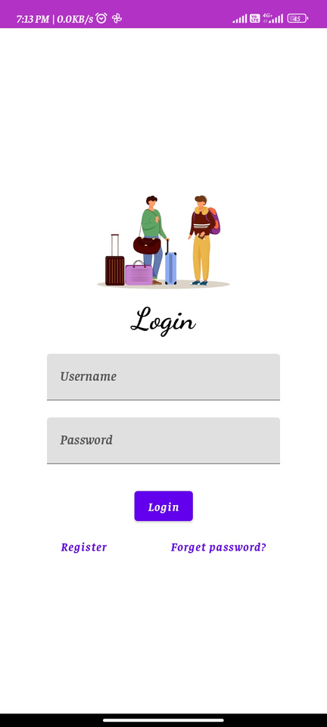
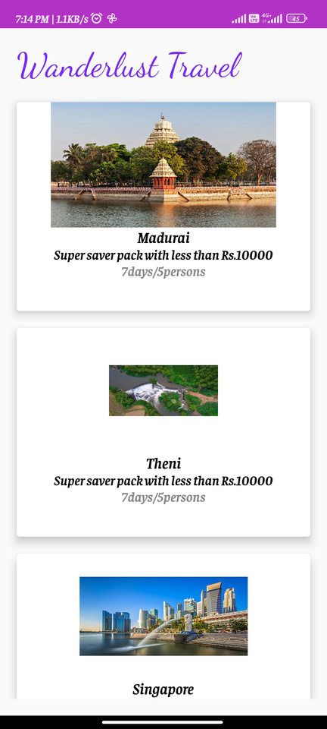
OUTPUT:

Slide 14
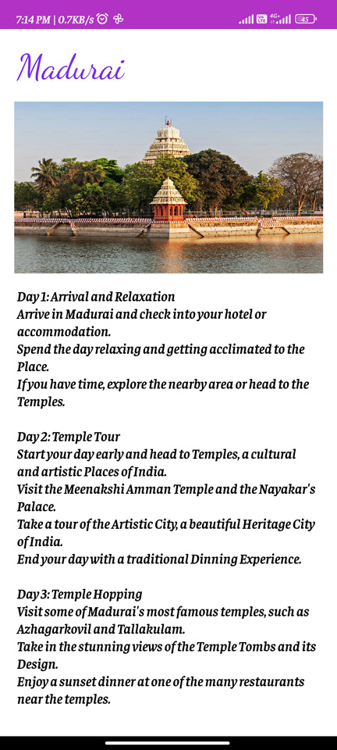
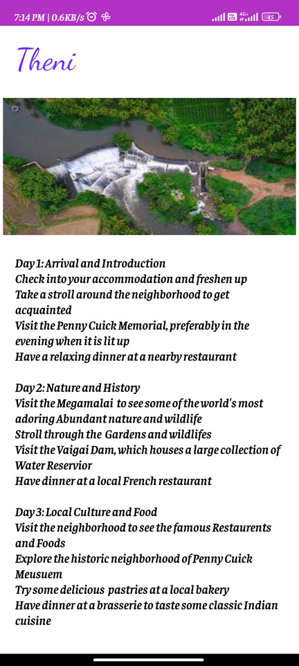
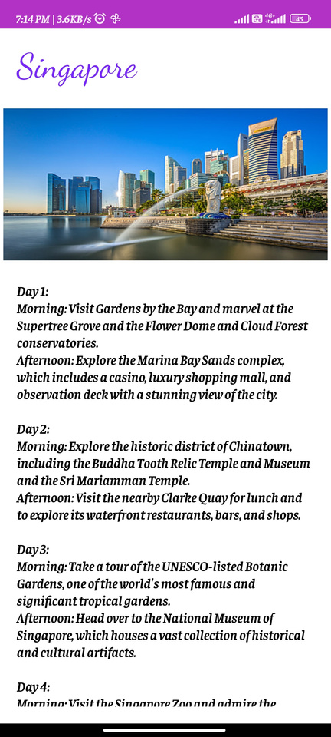

Slide 15
THANK YOU

